Slide 1
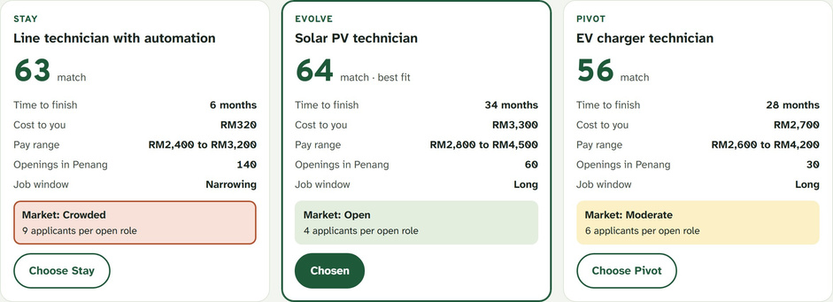
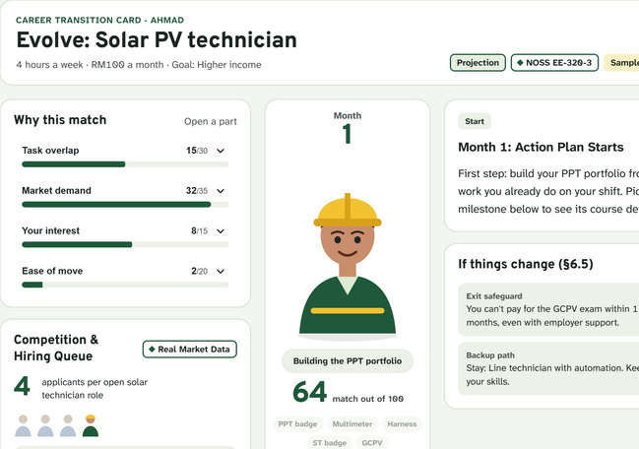
BIJAKMATCH
YourtrustedcareeradvisorforTVET workers
WORKING PROTOTYPE
PITCH DECK
SAME HANDS.
NEW WORK.
A career planner that reads a TVET worker's certificates and
real daily tasks, then shows a clear, affordable next step.
PREPARED BY
KMJDIHATIKU
[Event name · date]

Slide 2
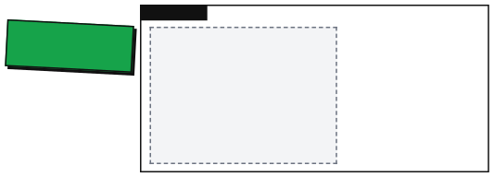
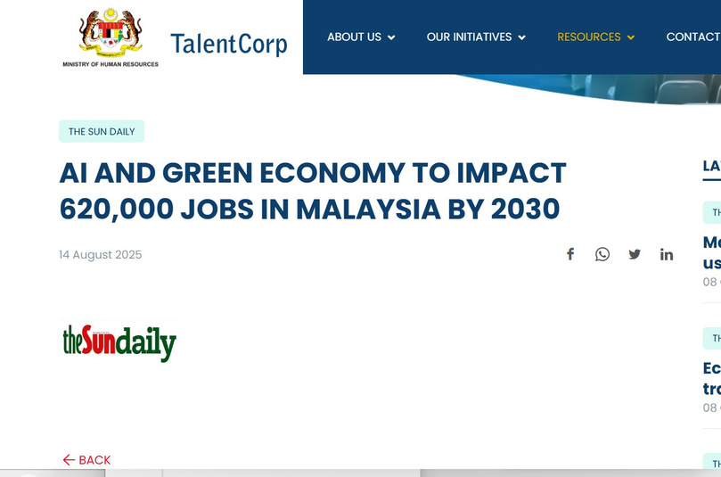
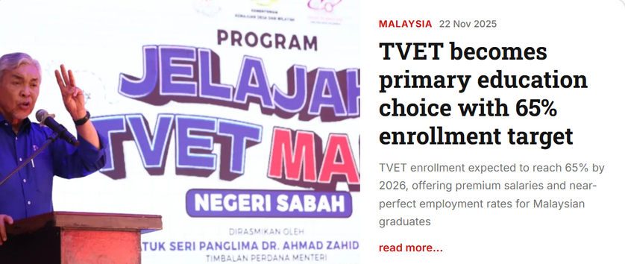
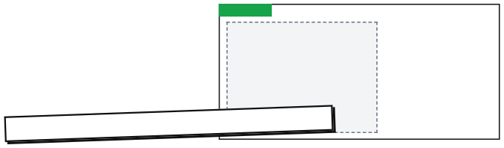
WHY NOW · 02
THE JOBS ARE CHANGING.
THE WORKERS ARE NOT READY.
TVET TODAY
HEADLINE
620,000
JOBS IMPACTED BY 2030
439,000
[Clipping: The Sun, Oct 2025 TVET enrolment headline]
GREEN JOBS
300,000
[Clipping: Malay Mail, 27 Aug 2025 green jobs headline]
The Sun Daily, via TalentCorp, 14 Aug 2025
CHANGE IS COMING. WHO GUIDES THEM?
Sources: The Sun Daily via TalentCorp, 14 Aug 2025 · Deputy Prime Minister via The Sun / Bernama, Oct 2025 · Human Resources Minister via Malay Mail, 27 Aug 2025 (NETR)

Slide 3
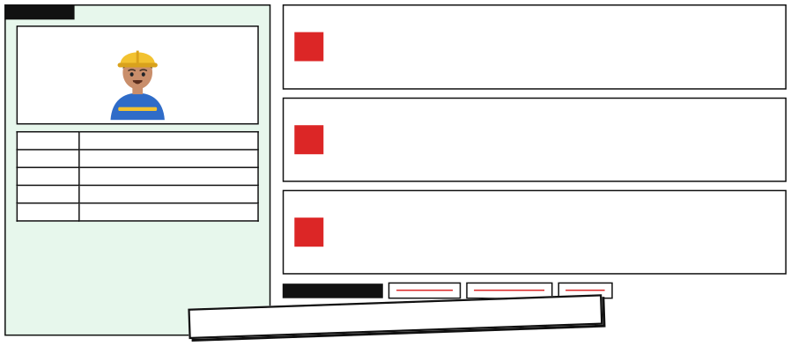

THE WORKER · 03
MEET ENCIK AHMAD.
THREE PROBLEMS, NO MAP.
ENCIK AHMAD
1
His CV can't show what he can do.
"Technician,5years"hidesthefaultshefixesandthe evidence he has.
2
AI news scares him. It doesn't guide him.
Age
28 · TVET graduate
He needs to know which tasks are changing, not a threat.
Job
E&E production technician, 5 years
Cer tif ic ates
SKM electrical + 1 HRD Corp short course
Time
4 hours a week, limited budget
Worry
"AI will replace technicians"
3
"Go green" has no first step.
Alastingskillorafad?Canhelearnitintime? Which licence is he missing?
THREE WRONG ROADS
Another degree
A generic AI course
Do nothing
WHAT CARRIES OVER? WHAT DO I DO FIRST?
Encik Ahmad is an illustrative profile; all of his data is synthetic.

Slide 4
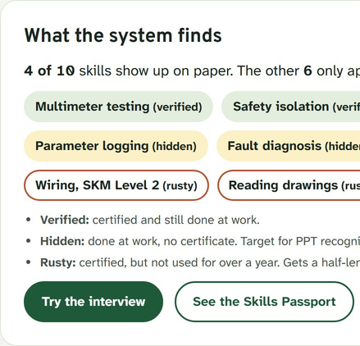
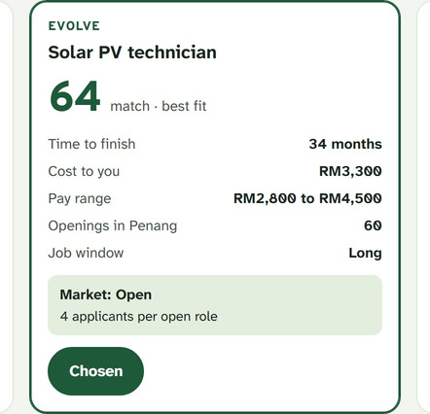
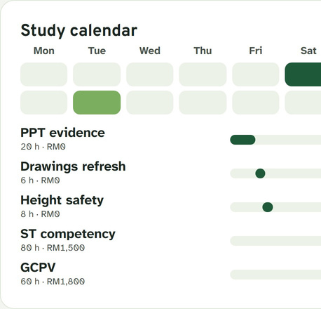
OUR SOLUTION · 04
THREE SCREENS.
ONE CLEAR NEXT STEP.
CERTIFY FIRST. THEN FILL THE GAP.
1 · UNDERSTAND
2 · DECIDE
3 · ACT
"What is changing in my job?"
"Stay, Evolve or Pivot?"
"What can I do this week?"
→
→
→
Verified, Hidden and Rusty skills
→
Explainable ranking for his state
→
Courses in a weekly calendar
RESULT
Career Transition Card: chosen path · first step within 4 weeks · cost and time · missing licences
Screenshots: BijakMatch prototype, sample worker. First step order: PPT recognition
refresh rusty skills
fill gaps
statutory licence.
→
→
→

Slide 5
WHY US · 05
WHAT ONLY BIJAKMATCH DOES.
01
02
SAME DATA, SAME
EVIDENCE BEYOND THE CV
Certificates + daily work log + shift interview.
ANSWER
Fixedrulesongovernmentopendata.AI never
decides.
03
MARKET-AWARE CHOICES
04
APLAN THAT REPLANS
Stay, Evolve or Pivot, with job crowding shown.
Missed a week or changed your mind? One tap.
NOT ANOTHER CV TOOL.
WHAT OTHERS DON'T DO
MyMAHIR: doesn't read your own certificates
MGTC Green Jobs: no match reasons, no crowding check
CV chatbots: can't read TVET skills, no sources
Comparison from the ReRole Green proposal's competitor review.

Slide 6
HOW IT WORKS · 06
AI READS AND EXPLAINS.
RULES DECIDE.
1 · INPUTS
Certificate upload
2 · AI LAYER
Whisper on RunPod GPU
speech-to-text
3 · AI TREND & MARKET SIGNALS
4 · RULE ENGINE
5 · OUTPUTS
Anthropic Economic Index
Match score
(+ SDG)
Path cards
Stay · Evolve · Pivot
SVM / SKM,whitelistcheck
observed AI use per task scenario
→
moderate
overlap+demand + interest + ease
Shift interview
Claude Opus 5.5 · GLM-5.3
Study calendar
voiceortyped,BM+ English
asks the interview questions
ILO GenAI Exposure Index
Window Score
.ics export
upper bound
→
accelerated scenario
demand−supply+pay premium
Daily work log
Task-card classifier (RunPod)
OpenDOSM · MyMAHIR
Licence gates
Transition Card
evidence for PPT
→
answer
→
NOSS task card
→
→
→
first step in 4 weeks
jobs and wages by state
SuruhanjayaTenaga, GCPV
LiveKit voice agent
live skill check
HRD Corp · MGTC Green Jobs
Weekly scheduler
courses, fees, green roles
hours, budget, intakes
Claude + web search
Dated snapshots
RULES.V1.JS · V1.0.0
state market report, with sources
release2026-03,re-ranks on update
AI reads and explains: listens, asks questions, sorts answers into task cards, researches the local market.
Rules decide: scores, ranking, course order and schedule. AI output is schema-checked and limited to our whitelists.
APIs: Anthropic API (Claude Opus 5.5) · RunPod serverless GPU (Whisper, task-card classifier, GLM-5.3) · LiveKit Cloud · certificate check uses our own rules, no AI. Data: Anthropic Economic Index, ILO, OpenDOSM, MyMAHIR, HRD Corp, MGTC.

Slide 7
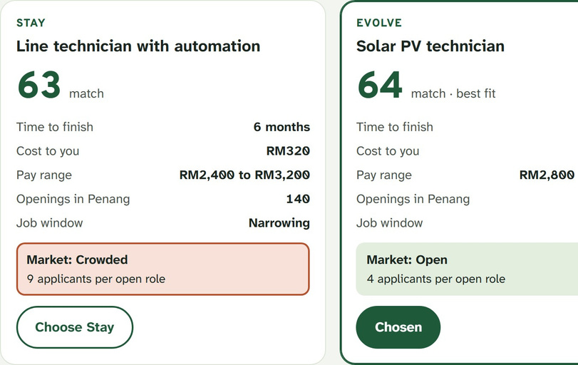
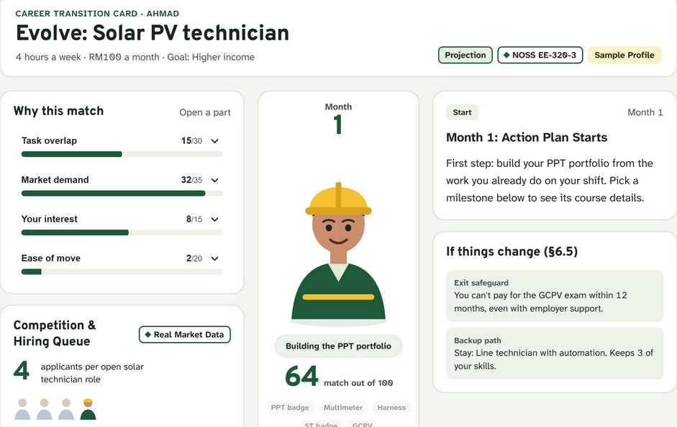
WHO CAN USE · 07
BUILT FOR THE WORKER.
USEFUL TO THE INDUSTRY.
TVET WORKERS
TVET COMPANIES & TRAINING PROVIDERS
EMPLOYER VIEW: NEXT
A PERSONAL PLAN
THE MARKET DIRECTION
Seetheskillstheyalready have, including hidden ones Compare Stay, Evolve and Pivot for their state
Get a plan that fits 4 hours a week
Which roles are growing, whicharecrowded
Which skills to train next, by state
Next: team skill-gap heatmap (employer view)
ONE CLEAR PICTURE OF WHERE JOBS ARE GOING.
The employer view is on the roadmap (proposal: future extension).

Slide 8
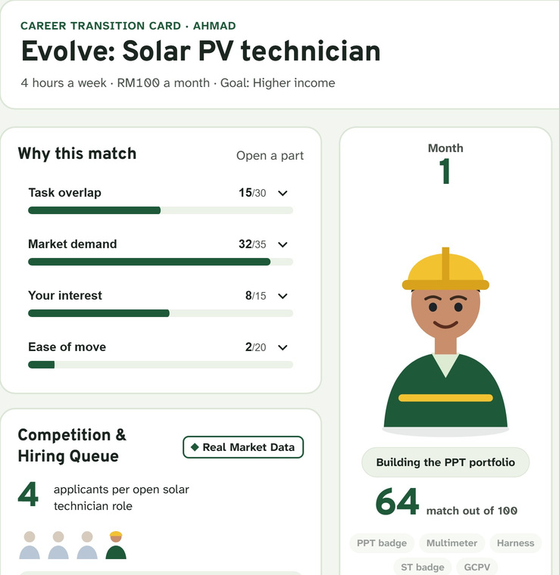
CLOSE · 08
WE DON'T PREDICT REPLACEMENT.
WE DESIGN THE
RESHAPING.
First certify what he knows. Then fill the gap. Then invest where the window is
longest.
NEXT
KMJDIHATIKU
[Pilot with a TVET provider] · [More green slices: water, waste] · [Bahasa Malaysia and Chinese UI]
[contact] · [demo link / QR]

